Slide 1
College of Western Idaho SWDV 210 Introduction to Server Side Programming
Week 1 Day 3

Slide 5
Notes:
CREATE DATABASE my_guitar_shop3;
CREATE DATABASE IF NOT EXISTS my_guitar_shop3;
CREATE DATABASE IF NOT EXISTS my_guitar_shop4;
USE my_guitar_shop3;
DROP DATABASE my_guitar_shop4;
DROP DATABASE IF EXISTS my_guitar_shop4;

Slide 6
Notes:
Open my_guitar_shop1
View columns in categories & orders

Slide 8
Notes:
Run the following in my_guitar_shop3:
CREATE TABLE customers
(
customerID INT,
firstName VARCHAR(60),
lastName VARCHAR(60)
);
CREATE TABLE customers2
(
customerID INT NOT NULL UNIQUE,
firstName VARCHAR(60) NOT NULL,
lastName VARCHAR(60) NOT NULL
);

Slide 9
Notes:
Run the following in my_guitar_shop3:
CREATE TABLE orders
(
orderID INT NOT NULL UNIQUE,
customerID INT NOT NULL,
orderNumber VARCHAR(50) NOT NULL,
orderDate DATE NOT NULL,
orderTotal DECIMAL(9,2) NOT NULL,
paymentTotal DECIMAL(9,2) DEFAULT 0
);

Slide 10
Notes:
Run the following in my_guitar_shop3:
#A table with a column-level primary key
CREATE TABLE customers2 (
customerID INT NOT NULL PRIMARY KEY
AUTO_INCREMENT,
emailAddress VARCHAR(255) NOT NULL UNIQUE
);
#A table with a table-level primary key
CREATE TABLE customers2 (
customerID INT NOT NULL AUTO_INCREMENT,
emailAddress VARCHAR(255) NOT NULL UNIQUE,
PRIMARY KEY (customerID)
);

Slide 11
Notes:
Run the following in my_guitar_shop3:
CREATE TABLE orderItems (
orderID INT NOT NULL,
productID INT NOT NULL,
itemPrice DECIMAL(10,2) NOT NULL,
discountAmount DECIMAL(10,2) NOT NULL,
quantity INT NOT NULL,
PRIMARY KEY (orderID, productID)
);

Slide 12
Notes:
Run the following in my_guitar_shop3:
ALTER TABLE customers4 RENAME TO customer;
ALTER TABLE customer ADD lastTransactionDate2 DATE;
ALTER TABLE customer ADD lastTransactionDate3 DATE
AFTER emailAddress;
ALTER TABLE customer DROP lastTransactionDate3;
ALTER TABLE customer
CHANGE emailAddress email VARCHAR(255) NOT NULL UNIQUE;

Slide 13
Notes:
Run the following in my_guitar_shop3:
ALTER TABLE customer ADD firstName VARCHAR(100) NOT NULL;
ALTER TABLE customer MODIFY firstName CHAR(100) NOT NULL;
ALTER TABLE customer MODIFY firstName VARCHAR(8);
ALTER TABLE customer ALTER firstName SET DEFAULT '';
ALTER TABLE customer ALTER firstName DROP DEFAULT;

Slide 14
Notes:
Run the following in my_guitar_shop3:
DROP TABLE customers2;
DROP TABLE IF EXISTS customers3;

Slide 15
Notes:
use my_guitar_shop3;
CREATE INDEX customerID
ON orders (customerID);
CREATE UNIQUE INDEX customerIDX
ON customers (customerID);
CREATE UNIQUE INDEX customerIDorderNumber
ON orders (customerID, orderNumber);
CREATE INDEX orderTotal
ON orders (orderTotal DESC);

Slide 16
Notes:
use my_guitar_shop3;
CREATE TABLE customers5 (
customerID INT NOT NULL AUTO_INCREMENT,
emailAddress VARCHAR(255) NOT NULL,
firstName VARCHAR(60) NOT NULL,
PRIMARY KEY (customerID),
UNIQUE INDEX emailAddress (emailAddress),
INDEX firstName (firstName)
);
DROP INDEX firstName ON customers5;

Slide 19
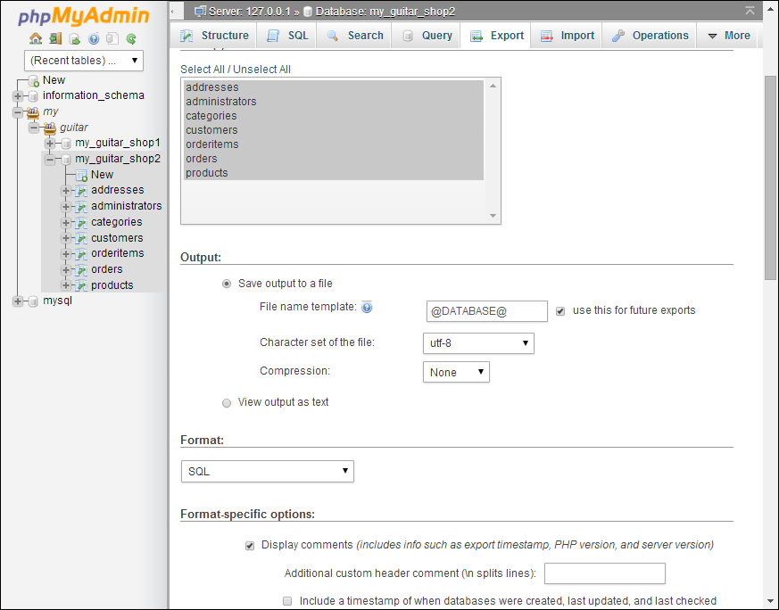
Notes:
Select my_guitar_shop3 & click export
Open export file

Slide 21
Key used to link two tables together.
One (or more) field(s) that refers to the PRIMARY KEY in another table.
CREATE TABLE orders2
(
orderID INT NOT NULL UNIQUE,
customerID INT NOT NULL,
orderNumber VARCHAR(50) NOT NULL,
orderDate DATE NOT NULL,
orderTotal DECIMAL(9,2) NOT NULL,
paymentTotal DECIMAL(9,2) DEFAULT 0,
FOREIGN KEY (customerID) REFERENCES customer(customerID)
);
Notes:
CREATE TABLE orders2
(
orderID INT NOT NULL UNIQUE,
customerID INT NOT NULL,
orderNumber VARCHAR(50) NOT NULL,
orderDate DATE NOT NULL,
orderTotal DECIMAL(9,2) NOT NULL,
paymentTotal DECIMAL(9,2) DEFAULT 0,
FOREIGN KEY (customerID) REFERENCES customer(customerID)
);

Slide 22
SWDV 210
Questions?

